Slide 1
PROBLEM IDENTIFICATION
AND ALTERNATIVE OPTIONS

Slide 2
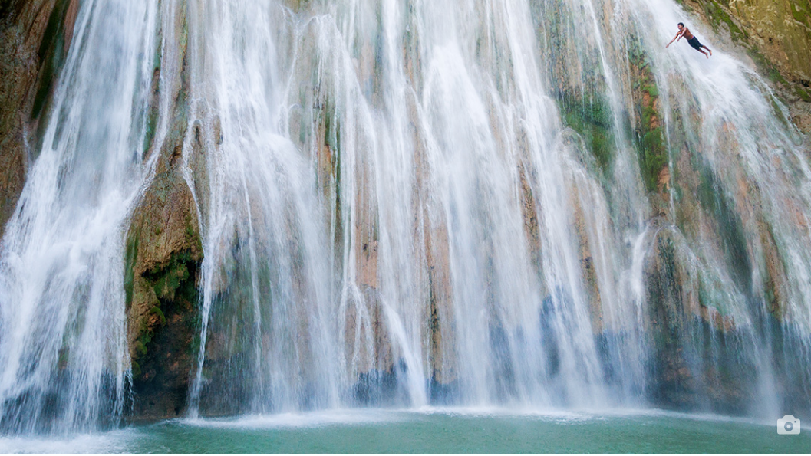
Finding Balance between Profitability & Corporate social responsibility
Growing 10% while maintaining environmental culture
Governance and succession
Brand awareness limiting growth
Product Lifecycle Initiative
Problem identification

Slide 3
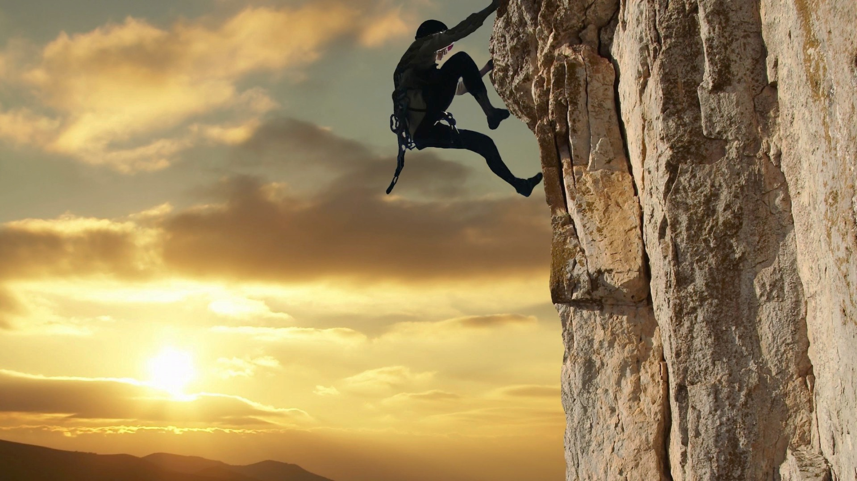
ALTERNATIVE OPTIONS
Continue Global Expansion (Asia and South America) & Maintain Product Lifecylce Initiative
Target new customer segment with 2nd hand swap market of PLI (push technology) & move forward with PLI plan
Sub-brand less exclusive & move forward with PLI plan
Tone down PLI and open up supply chain

Slide 4
Option 1- Continue Global Expansion (Asia and South America) & Maintain PLI plan
PROS
Increase of global presence
Bigger market
Booming Economy
Outdoor activities in South America
CONS
High cost of implementation
Time consuming
Lack of experience in Asian market

Slide 5
Option 2- Target new customer segment with 2nd hand swap market of PLI & move forward with PLI plan
PROS
New market segmentation- Increase in sales
In line with company’s vision
Reducing footprints
Reaching the mass market
Ease of implementation
CONS
Possible decrease in sales of the existing products
Hesitant to purchase 2nd hand products

Slide 6
Option 3- Sub-brand less exclusive & move forward with PLI plan
PROS
New target market- High potential of growth in sales
In line with company’s vision
CONS
High Implementation cost and time consuming
Distribution channel & Inventory Management
Higher competition
Existing clientele switching to the sub-brand

Slide 7
Option 4- Tone down PLI and open up supply chain
PROS
Increase in sales
Ease of implementation
Meeting the consumer demand
Inventory management + distribution channel
CONS
Against Corporate social responsibility
Mr.Chouinard will fire the consulting team

Slide 8
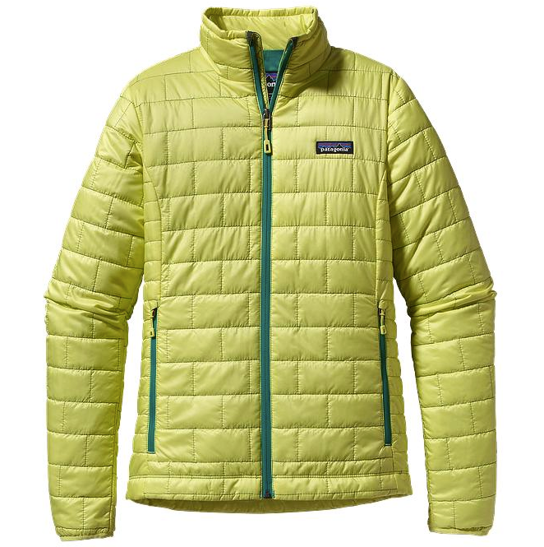
Decision Criteria
 | OPTION 1 | OPTION 2 | OPTION 3 | OPTION 4
ALIGNMENT WITH VISION
GROWTH
BALANCE
EASE OF IMPLEMENTATION
Total | 11 | 17 | 14 | 14

