Slide 1
Governance Issues Canachem Inc.
Presented by
Simon Foucher
Geneviève Lavigueur

Slide 2
BOARD
SCOTT
(Edward Parboyle)
Considered Lead, Chair of Comp.
YASIR
(Frank Masters)
SIMIN
(Joan McGovern)
Corporate Secretary
Ind. Director
General counsel
CHRISTIAN
(Solomon Binding)
Chairman
KRASTYO
(Charles Wright)
Ind. Director
From US

Slide 3
Executives
DIDIER
(Don Force )
JOSE
(Prudence Cash)
DAVID
(Harry Flash)
SVP Finance
SIMON
(Joe Burke)
CEO
COO
SVP Eng.

Slide 4
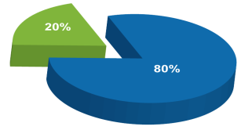
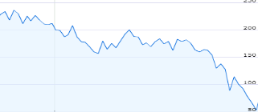
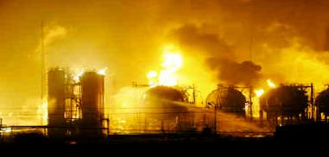
Company
British Parent
TSX Public
18 months

Slide 5
CONFLICTS
Don Force(CEO)
Busy with press, never @ office
Harry Flash
(SVP Eng)
Never speaks to CEO
Edward Parboyle
(Chairman)
No authority over CEO (Can’t force him to build plan)
Frank Masters
(Ind. Director)
Wants Don‘s head
Heard unfavorable things about Joe
Solomon Binding
(Considered Lead)
Told Edward That Frank and other ind. Want to remove Don
Charles Right
(Ind. Director)

Slide 6
CONFLICTS
Joe Burke (COO)
Been there 3 months
No exp. In chemicals
May have closed 3 plants
Solomon Binding
(Considered Lead)
Edward Parboyle
(Chairman)
Confirmed to Solomon that requested due diligence on Joe and heard Don plans to take over chair and make Joe CEO
Don Force(CEO)
Brushed aside concerns, pushed Joe to COO

Slide 7
INVESTIGATION
Solomon Binding
Head of Comp.
Investigation
Don(CEO)
Extended mortgage w/o permission
Edward (Chairman)
Offered unfunded pension to Don
Charles Right
(Ind. Director)
Letter to Edward to Remove Don, in Joe’s File (Not shown to committee)
Joe Burke
(COO)

Slide 8
TASKS
What are the issues for Solomon Binding to raise with the other independent directors?
What conclusions would it be reasonable for the independent directors to reach?
Do heads need to roll? If so, whose, and how?
What lessons are there for the board to take away from this episode?
How and to whom should Solomon communicate the conclusions and decisions made at this meeting?

